Slide 1
Flynn’s classification

Slide 2
Classification of parallel architectures
Flynn’s classification
SISD (Single Instruction Single Data)
SIMD (Single Instruction Multiple Data)
MISD (Multiple Instruction Single Data)
MIMD (Multiple Instruction Multiple Data)

Slide 3
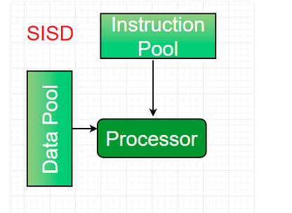
SISD

Slide 4
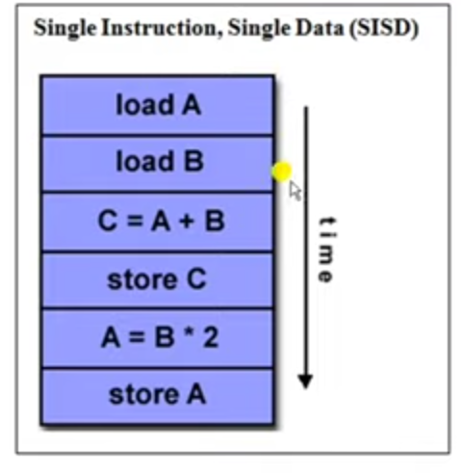
SISD

Slide 5
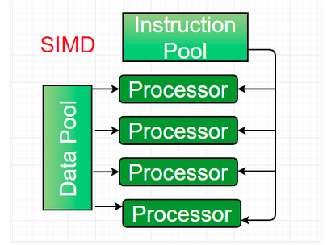
SIMD

Slide 6
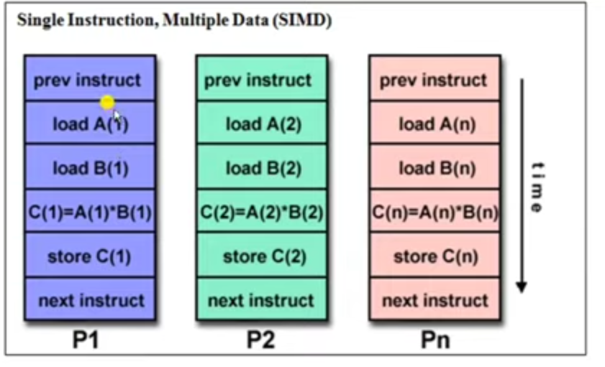
SIMD

Slide 7
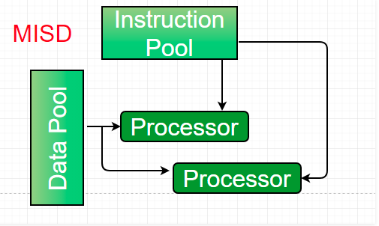
MISD

Slide 8
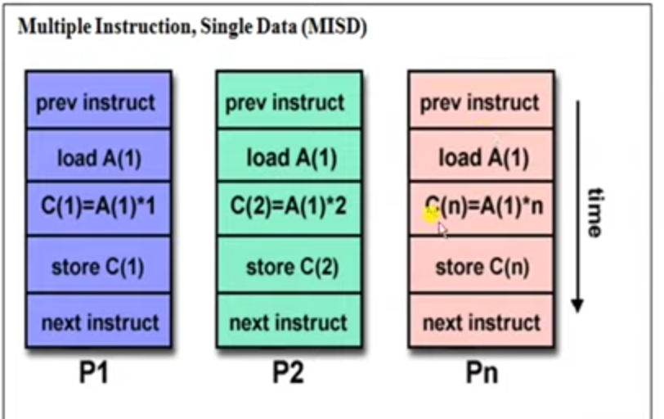
MISD

Slide 9
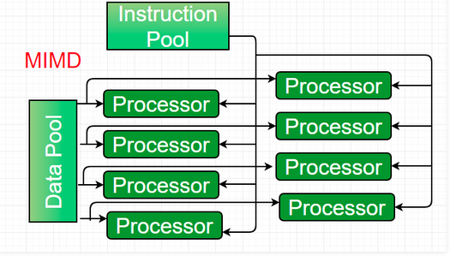
MIMD

Slide 10
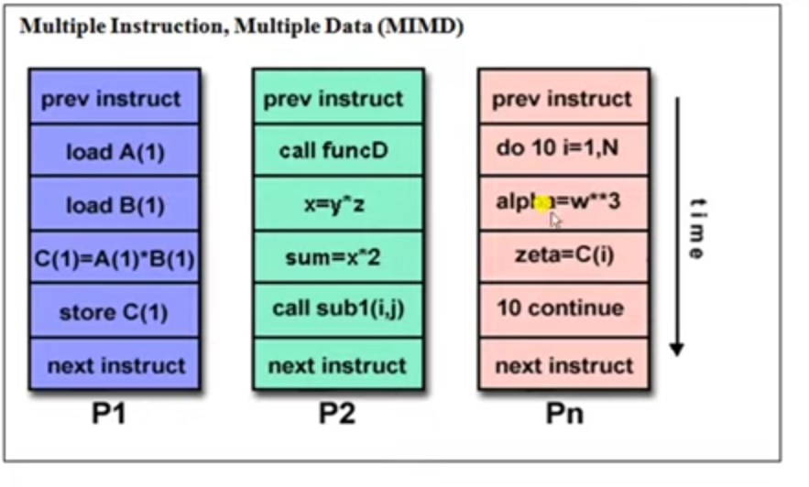
MIMD

